Slide 1
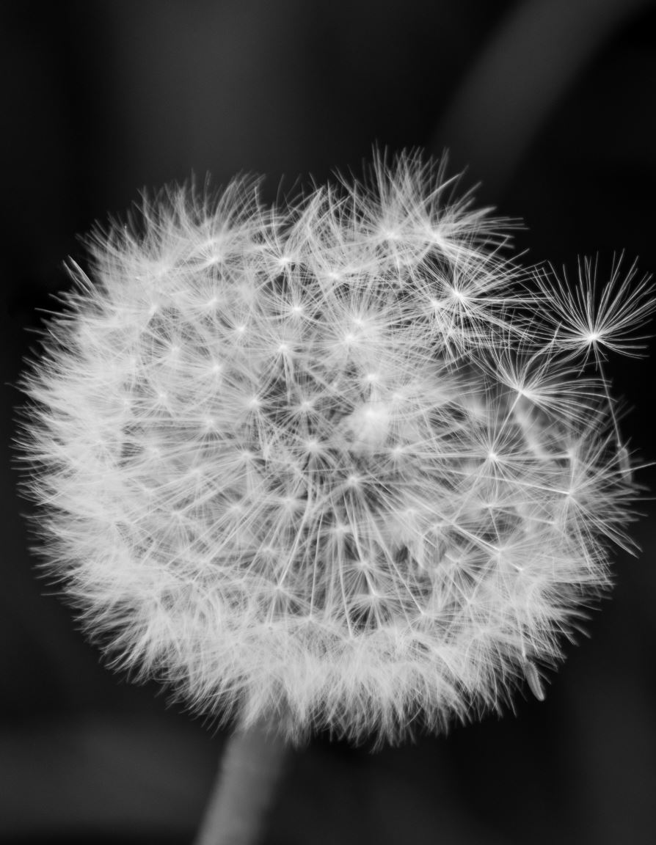
COLORIZING BLACK AND WHITE IMAGES
TEAM MEMBERS:​
K. VENKATESH(2010030359)​
M.AKHIL REDDY(2010030513)​
G. UDAY SAGAR(2010030411)​
P. VENKAT KISHORE(2010030569)
Guided By:-
Dr. Rajib Debnath

Slide 2
Outline
Introduction
Flow Chart
Conclusion
Implementation Steps
Architecture
Source Code
Implementation
Output
GitHub Repository

Slide 3
Introduction
Manual colorization of black and white images is a laborious task and inefficient. It has been attempted using Photoshop editing, but it proves to be difficult as it requires extensive research, and a picture can take up to one month to colorize.
Automated colorization of black and white images has been subject to much research within the computer vision and machine learning communities.
Automatic colorization of black and white images system takes black and white images as input and converts it into a colorful image

Slide 4
Implementation Steps
]
We are going to implement our model using two models i.e. using OpenCV and using CNN model with VGG19 architecture.
IMPLEMENTING USING OPENCV :
a. First input the image.
b. Convert the image into BGR Color Space.
c. Convert the image into “LAB” color space.
b. Resize the image, probably 224*224 pixels.
c. Extract the lightness values.
d. Using the lightness values colorize the black and white image.

Slide 5
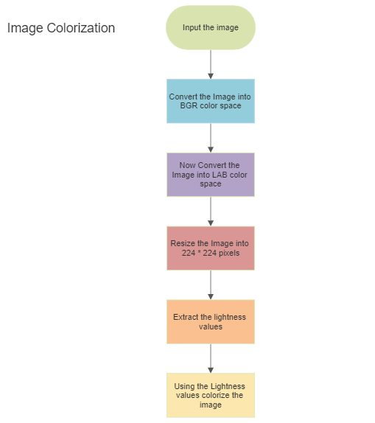
FLOW CHART
[OPEN-CV]

Slide 6
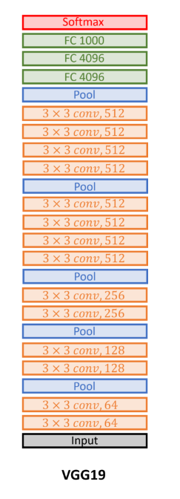
Architecture
[VGG-19]

Slide 7
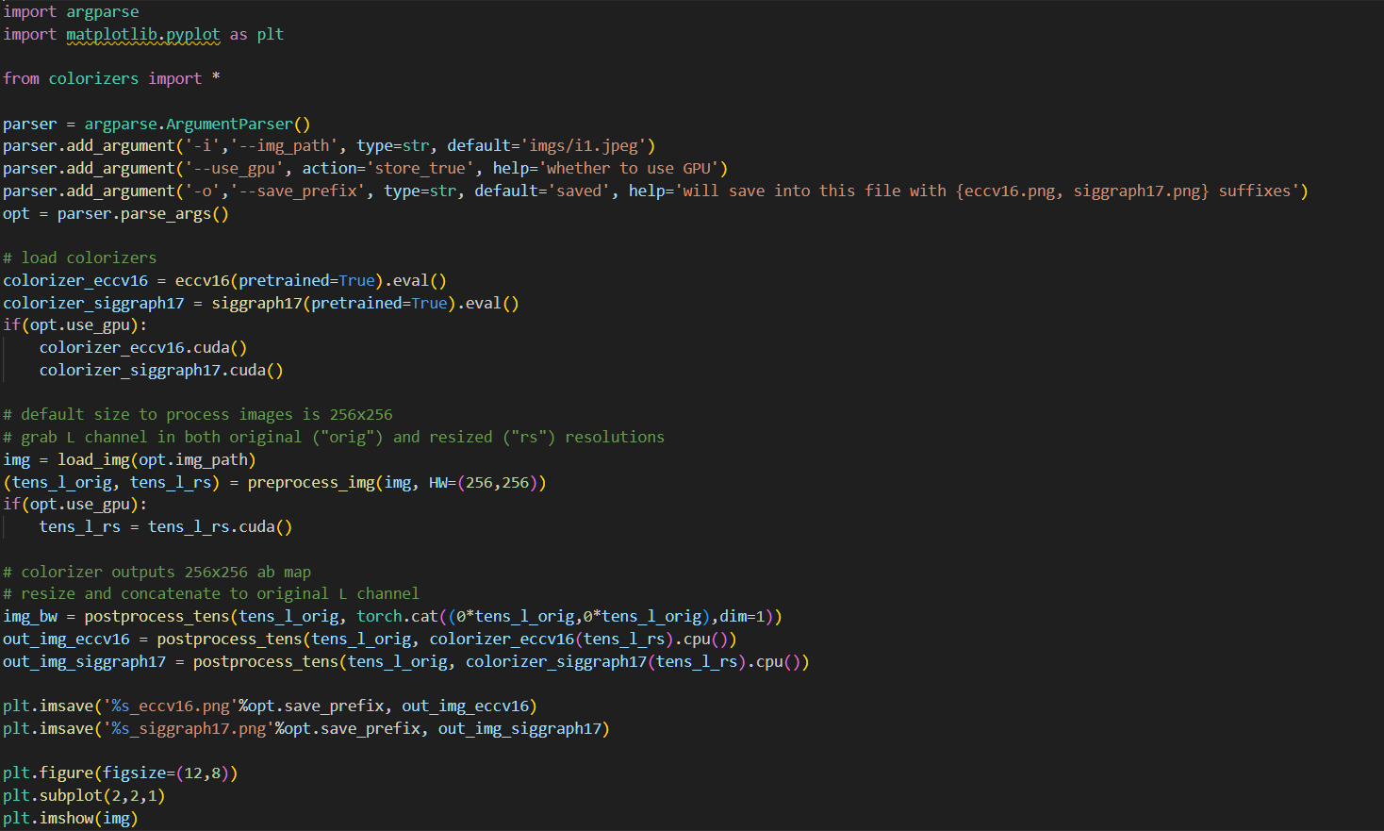
Source Code : -

Slide 8
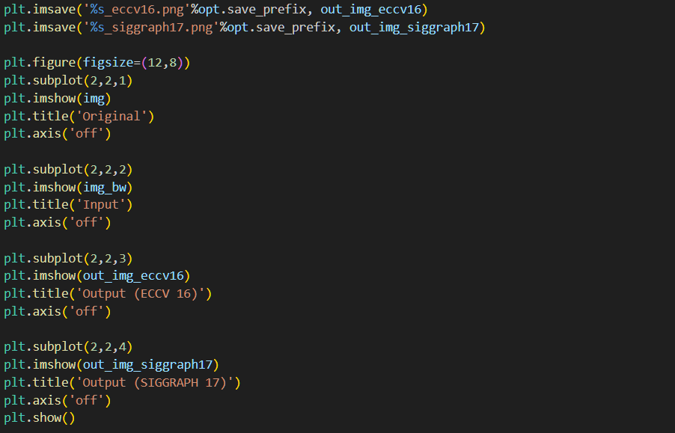

Slide 9
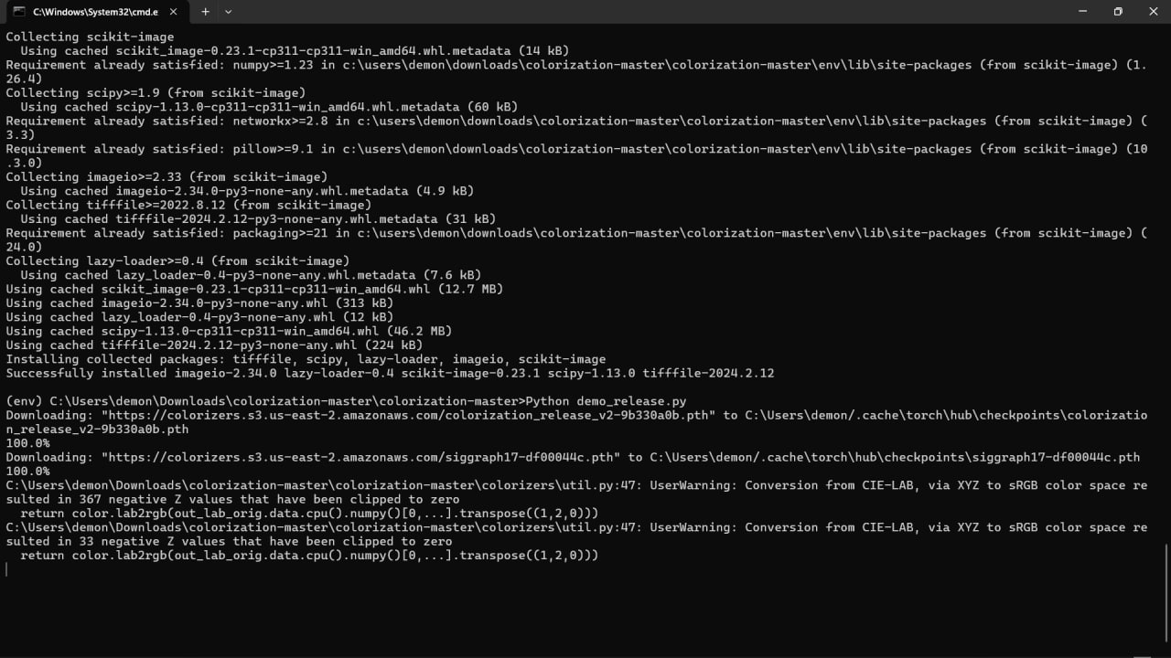
Implementation : -

Slide 10
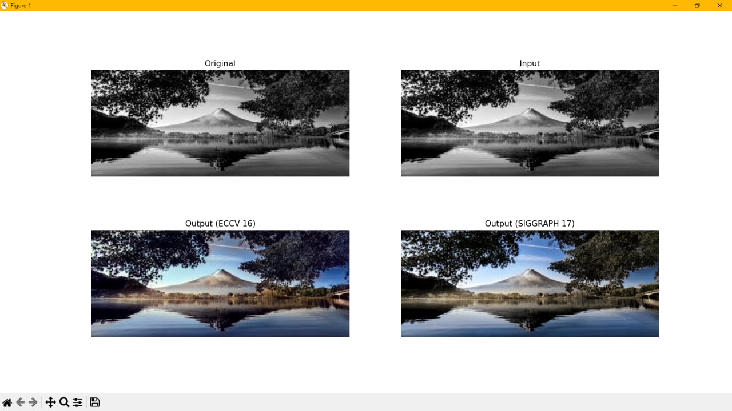
Output :-

Slide 11
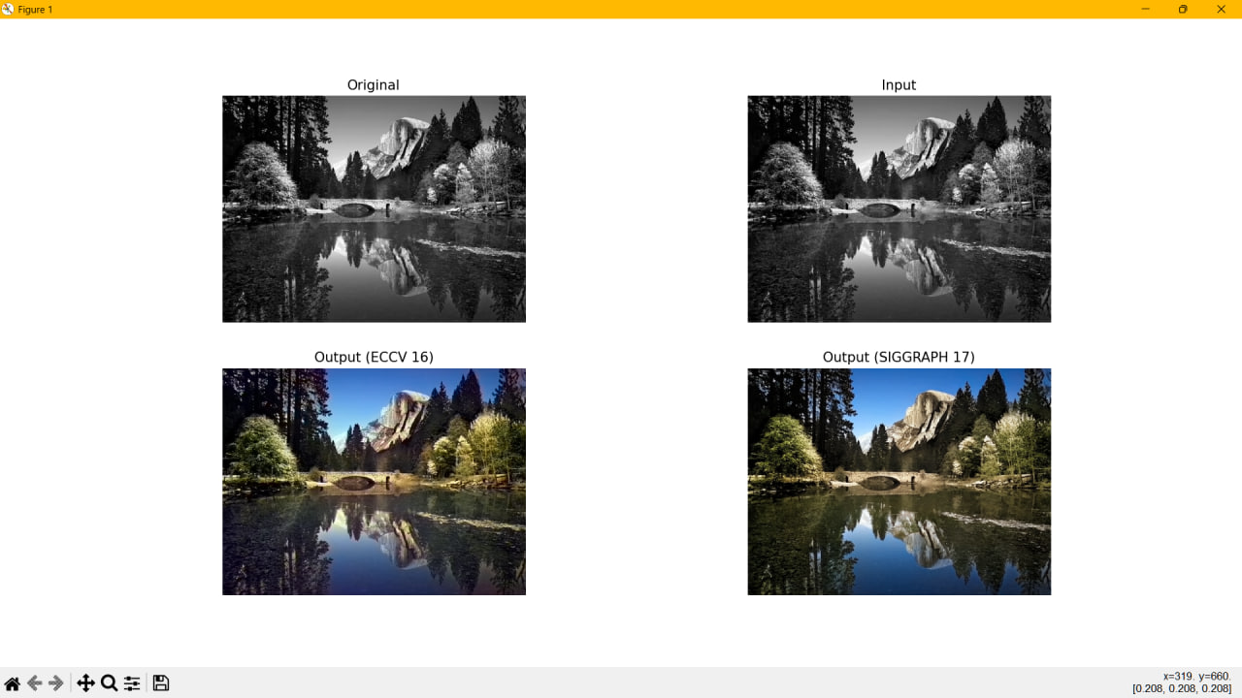

Slide 13
In recent years, with the vigorous development of computer hardware equipment, artificial intelligence has appeared more and more frequently in people’s vision.
Image automatic color not only can increase the interest in everyday life but also can improve the efficiency of some work, such as poster making, etc.
So, the gray image coloring technology has also attracted the attention of many researchers.
Conclusion : -

Slide 14


